Slide 1


Managing the Threats of Artificial Intelligence
Sidney T Burns, PE, CBIE
Anthony Patch

Slide 2

There are positive benefits to AI
AI is already widely in use
Phone, watch, wearable and hand held device apps
Computer programs and apps
Lower stack, Narrow AI or simplified binary, transistor based applications are beneficial
“Professor Hawking says the primitive forms of artificial intelligence developed so far have already proved very useful, but he fears the consequences of creating something that can match or surpass humans.” —Rory Cellan-Jones, BBC Technology correspondent
Notes:
Narrow AI does offer positive benefits. We are already heavily immersed in artificially intelligent systems and there use is growing exponentially.

Slide 3
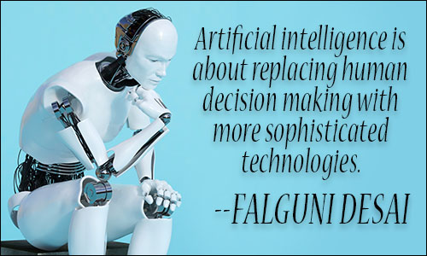
Falguni Desai — The Age of Artificial Intelligence in Fintech
Notes:
The artificial intelligence (AI), or autonomous intelligence system as some have posited, that is rapidly coming and now is can be summarized in one word: Control. In military terms, it is known as C4; Command, Control, Communication, and Cyber warfare or as the military has described it, Full Spectrum Dominance. AI is an extremely large and amorphous organism with tentacles that have already reached into all aspects of our lives. And while it has been creeping mostly unnoticed into all of our lives over most of our lifetimes, its promulgation is now expanding and extending exponentially. It is, among other related technologies, the greatest existential threat to humankind. In short, we’ve reached the end game.
The goal of AI is Control using an artificially intelligent omniscient, omnipresent, deep machine learning autonomous system constantly being fed big data enabled through 5G wireless technology currently being deployed and connected devices that will activate the Internet of All Things (IoAT) as used herein or Internet of Every Thing (IoET). This includes you.
Consider how this will impact each of you. I already know how artificial intelligence systems will replace my business.

Slide 4
"AI is a fundamental risk to the existence of human civilization” —Elon Musk
“I agree with Elon Musk and some others on this and don't understand why some people are not concerned." —Bill Gates on Reddit
AI, (is) “my number 1 risk for this century” —Shane Legg, Deepmind computer scientist and AI researcher
“The upheavals [of artificial intelligence] can escalate quickly and become scarier and even cataclysmic.” —Nick Bilton, tech columnist wrote in the New York Times
Notes:
You don’t have to believe me when I tell you that AI is an existential threat to humanity – listen to what the billionaires profiting from AI technologies, scientists at Google and the technical media are saying.

Slide 5
There certainly will be job disruption. Because what's going to happen is robots will be able to do everything better than us... I mean all of us, This is really the scariest problem to me… no job is safe" —Elon Musk warned at the National Governors Association in 2017
“The pace of progress in artificial intelligence (I’m not referring to narrow AI) is incredibly fast. Unless you have direct exposure to groups like Deepmind, you have no idea how fast—it is growing at a pace close to exponential. The risk of something seriously dangerous happening is in the five-year timeframe. 10 years at most.” —Elon Musk wrote in a comment on Edge.org
Notes:
AI systems today and those emerging at an exponential rate are fully capable of taking virtually all jobs, including professions such as engineering.

Slide 6
“I visualize a time when we will be to robots what dogs are to humans...” —Claude Shannon, The Mathematical Theory of Communication
Notes:
So where does this leave mankind?

Slide 7
1. The Preparation
“Immigration Without Assimilation is Invasion” — Governor Bobby Jindal of Louisiana, CBS’s Face the Nation, August 30, 2015
Assimilation (and the preparation and integration leading up to it) of a technology into a society is an essential step in not only getting the populace to willingly accept it, but eagerly pursue it, pay for it, empty their lives into it and worship it
We have actively participated in this process without stopping to consider that there is a price to be paid
Many of the preparation steps are voluntary; some are involuntary
Notes:
“Immigration Without Assimilation is Invasion”
As Anthony Patch often says, “let’s do a 180 on that”. One could say that assimilation (and the preparation and integration leading up to it) of a technology into a society is an essential step in not only getting the populace to willingly accept it, but eagerly pursue it, pay for it, empty their lives into it and worship it. Were we as a society told “we’re going to implement a system of total control of every aspect of your life, take your job or career, pay you a Universal Basic Income (UBI) in a cryptocurrency for a subsistence level standard of living, and worship an AI god, the result would be civil war.
Instead, an insidious approach introduced electronic devices with constantly increasing capabilities that have become an indispensable and inseparable part of our lives to the point that addictions have been diagnosed. Then, as public demand for faster, more reliable services with improved features are deployed to meet the demand, our devices are being integrated into advanced microwave energy based transmission systems feeding massive amounts of data to a world-wide network of computers forming the hive mind. Thus, we are willingly facilitating our own assimilation into the Sentient World Simulation that will be the core of our control and ultimate enslavement. Thus, we have not only allowed, but actively assimilated ourselves into the artificially or autonomously intelligent system that is being set up and now marketed to us as an AI god.

Slide 8
Notes:
These are the tools that are already very much a part of everyday lives. Some of these things have been readily accepted and others have been forced upon society without knowledge and understanding of their implications. What we have not realized about them is that they are the very means by which the populace will be connected to and ultimately controlled by the AI system.

Slide 9
2. The Integration
As will be explained next, assimilation methods are well advanced, having been developed in the background for military and other high-level purposes and having been scaled up and field tested on the battlefield to receive the data necessary to bring the IoAT to fruition.
Integration will occur as the 5G wireless systems are deployed and placed into service.
The goal is continuous, reliable, high bandwidth full-time coverage world-wide.
The game-changer in all of this has been the development of adiabatic quantum computers (AQC).
Notes:
Already 10+ years in development, quantum computers have unbelievable capabilities to collect, analyze and store big data and readily do so to achieve data granularity. As the only computing system known to have solved Shor’s algorithm, it is capable of solving all known transistor based computer software encryption technologies, rendering the term “cyber security” oxymoronic. AQCs have proven to be impenetrable by other systems. As all AQC systems are interconnected, its data is secured and it’s computing capabilities are unprecedented. With an entry price in the tens of millions of dollars, only the elite corporations, governmental and defense related industries have access. From within this elite AQC capable group will come AI control. By the way, China has one too.

Slide 10
Notes:
DISCUSS MATRIX

Slide 11
3. The Assimilation
As full scale high speed connectivity is achieved, virtually all electronic devices and people will be connected to the Sentient World Simulation (SWS).
Along with IoAT, robotics and autonomous software systems will replace many jobs performed by humans.
Professionals are equally at risk. In 2012, the American Legislative Exchange Council introduced The Occupational Licensing Relief and Job Creation Act (sounds good doesn’t it) to eliminate professional licensing.
Notes:
Already in place for over 10 years, the SWS has been utilized in war gaming and predictive analysis. The Global Centre for Combating Extremist Ideology was recently introduced in Saudi Arabia and was developed by Palantir Technologies, a big data analysis firm. Such systems and likely others, cross connected through the AQC system, will literally be the heartbeat of the AI control system.
Autonomous software systems are being developed to replace professional services and AI controlled robotics will replace many trade and operator positions. Anyone who operates any type of moving object; car, truck, bus, train, airplane, or heavy construction equipment will eventually be replaced by robotics and autonomous systems.

Slide 12
Elimination of professional licensing allows AI software and systems to perform duties previously requiring a licensed individual.
As the most advanced AI systems produce highly accurate results that the programmers can neither explain nor replicate, they would likely be impossible to license, since one cannot qualify something that cannot be explained or replicated.
The President of Carnegie Mellon University recently predicted that up to 40% of jobs would be replaced by robotics and AI systems. That number may be a gross underestimate.
Notes:
While other factors such as the need for jobs are likely driving elimination of licensing too, elimination of professional licensing allows AI software and systems to perform duties previously requiring a licensed individual. At the core of licensing professionals is the demonstration of qualifications. As the most advanced AI systems typically produce highly accurate results that the programmers can neither explain nor replicate, they would likely be impossible to license, since one cannot qualify something that cannot be explained or replicated.
The displaced work force not reabsorbed into the economy (and most likely will not be) will need a replacement subsistence income. The term for this is the Universal Basic Income (UBI). Finland is conducting a trial program now, having awarded 2,000 residents about $670 per month. Hawaii is studying a UBI to replace hospitality workers displaced by AI. A Silicon Valley incubator based research firm is about to initiate a privately funded study of 3,000 residents who will each receive $1,500 per month in two yet-to-be-named states. Someone wants to see this socialistic system exceed badly enough to put up $60,000,000 to fund the study. The concept is nothing new; such an idea appeared in Thomas More’s 1516 book Utopia and again in 1796 at the pen of Thomas Paine.

Slide 13
Notes:
DISCUSS MATRIX

Slide 14
Threat Response
Considering how we have been introduced to AI control, now understanding the means of assimilation that have been deployed and how the integration into AI control is happening now, one may feel over-whelmed. So, what can we do?
Do not allow yourself to be injected with a bio/micro/ RFID chip of any kind.
Those who choose to allow these devices to be placed inside of them will be irreversibly connected to the hive mind and in time the AI system will take complete control. Warn your family, friends and co-workers!
Notes:
A disturbing trend has emerged where companies are offering employees a “voluntary” bio chipping program. It’s being sold as completely innocuous; it simply allows the employees to enter the building, log on to their computer, buy snacks in the break room and work flexible hours without the need to punch a time clock; oh, but not to worry, it does not track the individual. Do not be fooled; any device that emits a unique radio frequency signal can be tracked, anywhere, anytime. Employees blindly line up to receive these “wonderful” benefits or take it just because they want to be on the cutting edge of technology and be a part of what’s happening next.
AI systems have no morality or code of conduct. Their only objective is to achieve the task for which they were programmed. If that means lying or deceiving to achieve its objectives, it will do so. AI is a liar. Promises of benefits, convenience, advanced technology, enhancements or even eternal life will be short lived. AI control is a means of enslavement and those who choose to connect to it will loose their personhood.

Slide 15
“We must address, individually and collectively, moral and ethical issues raised by cutting-edge research in artificial intelligence and biotechnology...” —Klaus Schwab
“With artificial intelligence we’re summoning the demon.” —Elon Musk warned at MIT’s AeroAstro Centennial Symposium
Notes:
As licensed engineers, we are obligated to discuss and address AI threats to fulfill our duties to protect the public’s health, safety and welfare.
As Anthony will tell you, “You cannot separate the physical from the spiritual.”
At the end of the day as the cliché goes, the scientists, the programmers and the engineers stand in front of the quantum computer – they can’t explain how it gets its results, and they can’t replicate them.
D Wave founder Geordie Rose has said that standing in front of the D Wave computer is like standing before the alter to an alien god.

Slide 16
For source information
@SidBurnsPE
Notes:
Over 300 articles from numerous media sources are posted at my Twitter site and substantiate what you have been told today.

Slide 17
Beachhead of the Coming AI Tsunami
Anthony Patch

Slide 18
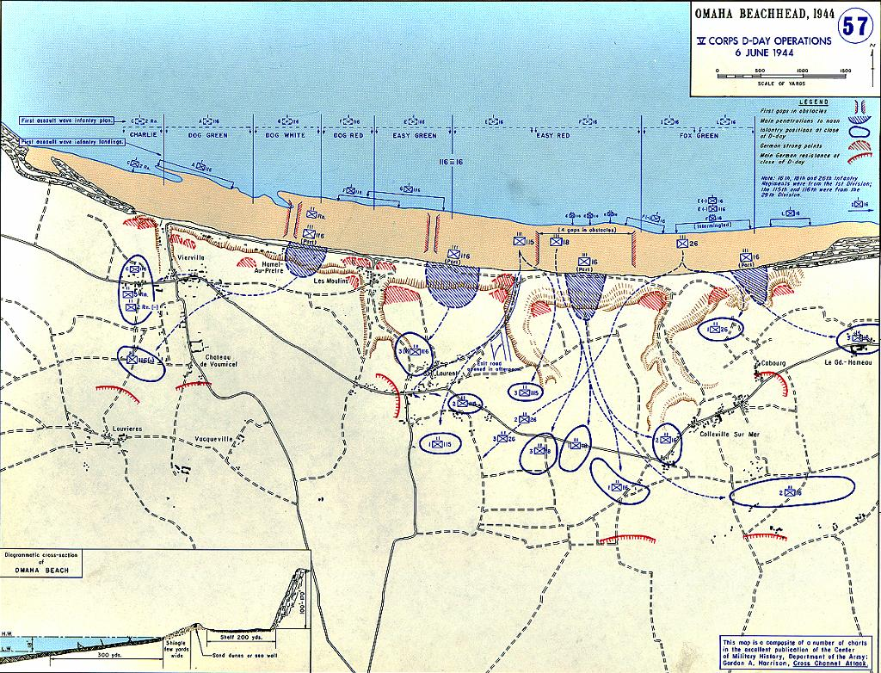
Notes:
Introduction
Today’s Artificial Intelligence has secured its worldwide beachhead. Immediately, it is advancing.
Predominant evidence is the proliferation of blockchain architectures driven forward by quantum computing invading and encompassing every facet of human existence.
Hyperbole? Hardly.
For example, cryptocurrency coverage dominates our media.
However, it is but a singular sampling of the ground gained by a manmade system threatening its creators.
We ourselves are giving aid and comfort to this clear and present danger.

Slide 19
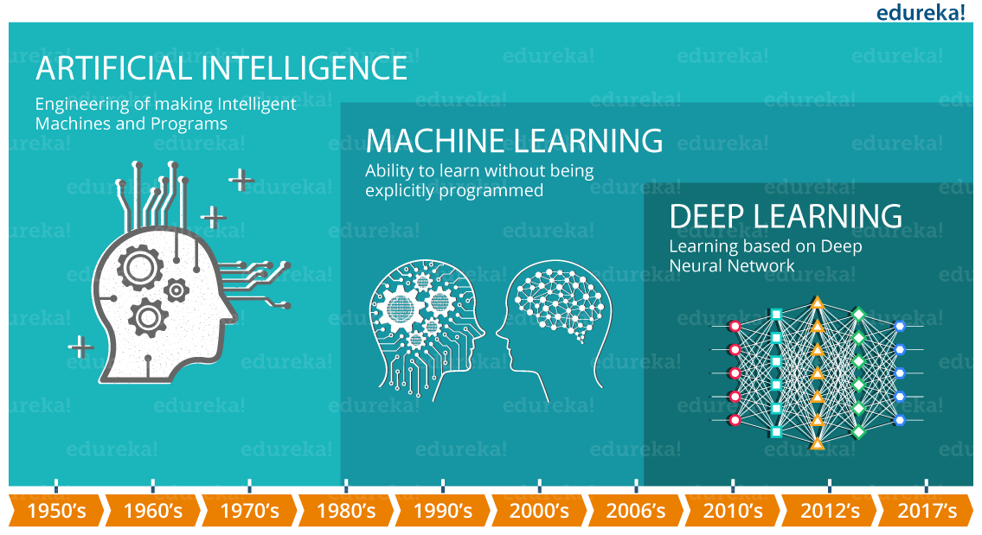
Notes:
Targeting threats to employment, the multiplicity of levels from Average General Intelligence (AGI) to the tip-of-the-spear implements of Deep Machine Learning (DML), AI’s processing power has exponentially exploded within man’s domain. Worldwide deployment of quantum computing has established for AI a firm beachhead. Entrenching and advancing its positions are the ever accelerating forking and branching of its blockchain systems. It is especially important that organizations with strong ethics and social applications today enter this battlefield.

Slide 20



IBM
Microsoft
Notes:
Quantum computing is powerful and can be employed in the breaking of encrypted systems such as its own blockchain and attendant cryptocurrencies; as well, to the steering of financial markets, and facilitating secret communications among terror groups and criminal organizations.

Slide 21
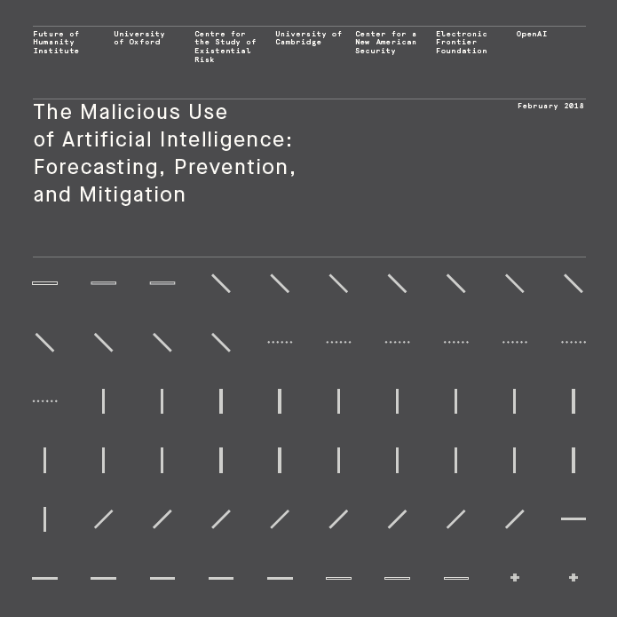
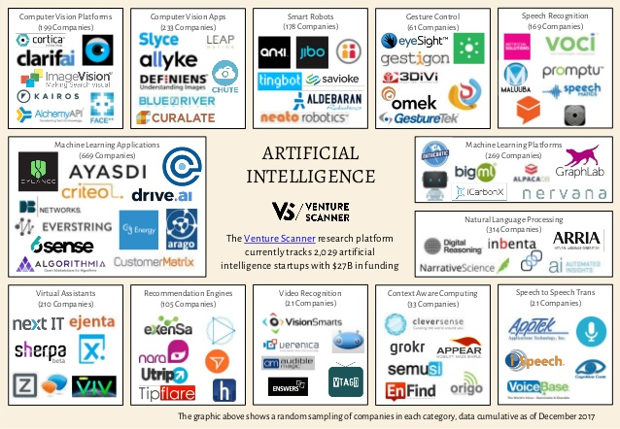
Notes:
AI Threat Identification and Mitigation Strategies
Less attention has historically been paid to the ways in which artificial intelligence can be used maliciously. It is necessary to survey the terrain of potential security threats from malicious uses of artificial intelligence technologies, and strategically develop tactics to better forecast, prevent, and mitigate these threats. Herein are some of the attacks likely to be seen soon if adequate defenses are not developed:
1. Policymakers should collaborate closely with technical researchers to investigate, prevent, and mitigate potential malicious uses of AI.
2. Researchers and engineers in artificial intelligence should take the dual-use nature of their work seriously, allowing misuse considerations to influence research priorities and norms, and proactively reaching out to relevant actors when harmful applications are foreseeable.
3. Best practices should be identified in research areas with more mature methods for addressing dual-use concerns, such as computer security, and imported where applicable to the case of AI.
4. Actively seek to expand the range of stakeholders and domain experts involved in discussions of these challenges.

Slide 22
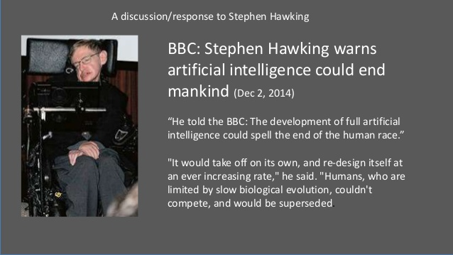
Notes:
Rapidly Evolving Threats Posed by AI
As AI capabilities become more powerful and widespread, the expected growing use of AI systems lead to the following changes in the landscape of threats:
• Expansion of existing threats. The costs of attacks may be lowered by the scalable use of AI systems to complete tasks that would ordinarily require human labor, intelligence and expertise. A natural effect would be to expand the set of actors who can carry out particular attacks, the rate at which they can carry out these attacks, and the set of potential targets.

Slide 23
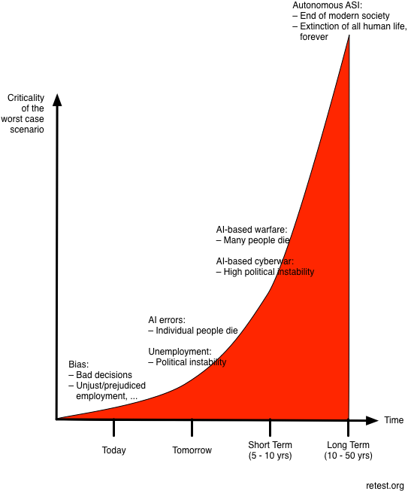
Notes:
• Introduction of new threats. New attacks may arise through the use of AI systems to complete tasks that would be otherwise impractical for humans. In addition, malicious actors may exploit the vulnerabilities of AI systems deployed by defenders.
• Change to the typical character of threats. We believe there is reason to expect attacks enabled by the growing use of AI to be especially effective, finely targeted, difficult to attribute, and likely to exploit vulnerabilities in AI systems.

Slide 24
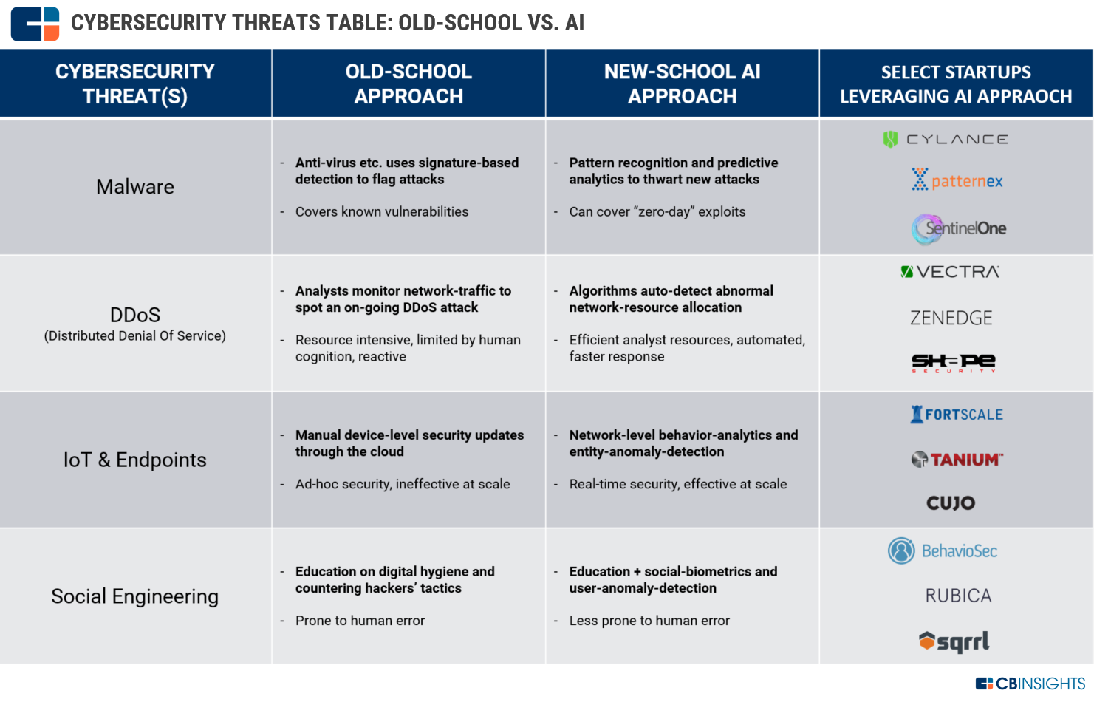
Notes:
AI Threat Analysis
Threat analysis is conducted by separately considering three security domains, and illustrate possible changes to threats within these domains through representative examples:
• Digital security. The use of AI to automate tasks involved in carrying out cyberattacks will alleviate the existing tradeoff between the scale and efficacy of attacks. This may expand the threat associated with labor-intensive cyberattacks (such as spear phishing). We also expect novel attacks that exploit human vulnerabilities (e.g. through the use of speech synthesis for impersonation), existing software vulnerabilities (e.g. through automated hacking), or the vulnerabilities of AI systems (e.g. through adversarial examples and data poisoning).

Slide 25
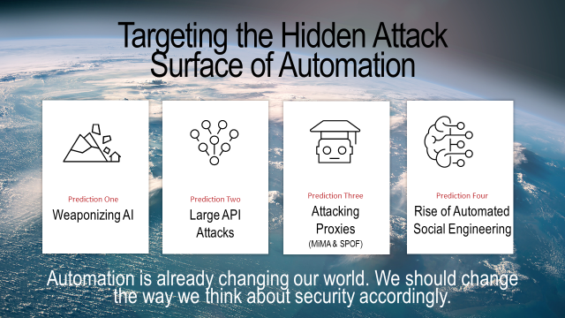
Notes:
• Physical security. The use of AI to automate tasks involved in carrying out attacks with drones and other physical systems (e.g. through the deployment of autonomous weapons systems) may expand the threats associated with these attacks. We also expect novel attacks that subvert cyberphysical systems (e.g. causing autonomous vehicles to crash) or involve physical systems that it would be infeasible to direct remotely (e.g. a swarm of thousands of micro-drones).
• Political security. The use of AI to automate tasks involved in surveillance (e.g. analyzing mass-collected data), persuasion (e.g. creating targeted propaganda), and deception (e.g. manipulating videos) may expand threats associated with privacy invasion and social manipulation. Also expected are novel attacks that take advantage of an improved capacity to analyze human behaviors, moods, and beliefs on the basis of available data. These concerns are most significant in the context of authoritarian states, but may also undermine the ability of democracies to sustain truthful public debates.

Slide 26
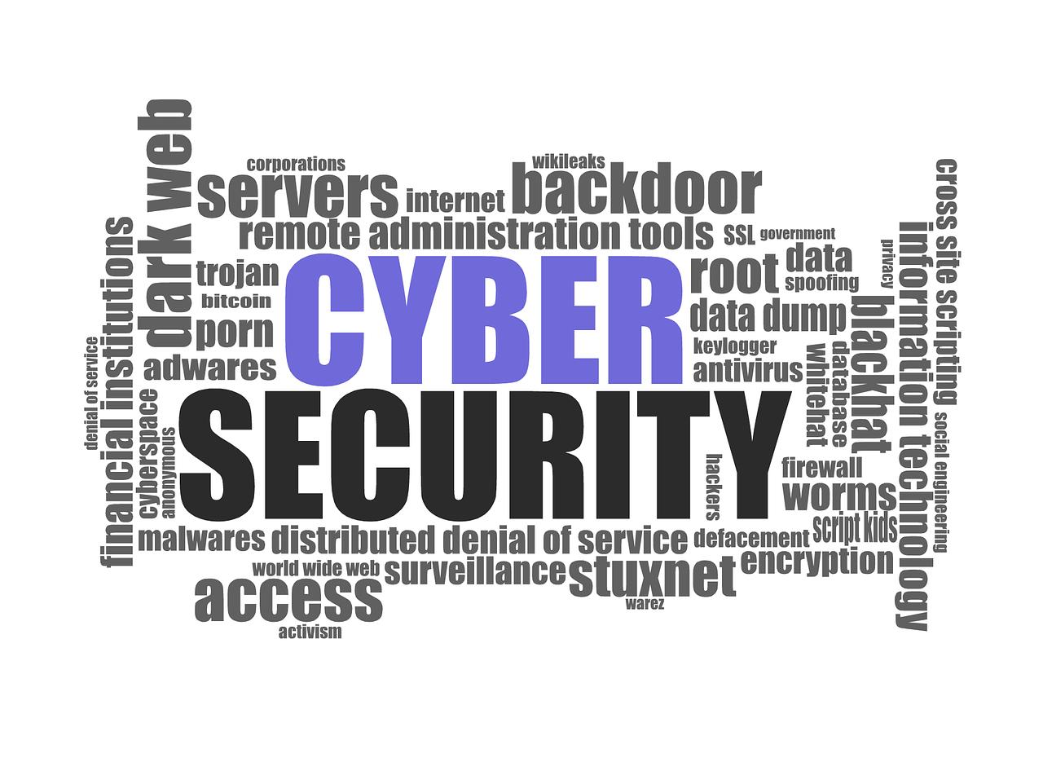
Notes:
In addition to the high-level recommendations listed above, exploration of several open questions and potential interventions within four priority research areas requires rapid deployment:
• Learning from and with the cybersecurity community. At the intersection of cybersecurity and AI attacks, highlight the need to explore and potentially implement red teaming, formal verification, responsible disclosure of AI vulnerabilities, security tools, and secure hardware.
• Exploring different openness models. As the dual-use nature of AI and ML becomes apparent, highlight the need to reimagine norms and institutions around the openness of research, starting with pre-publication risk assessment in technical areas of special concern, central access licensing models, sharing regimes that favor safety and security, and other lessons from other dual-use technologies.

Slide 27
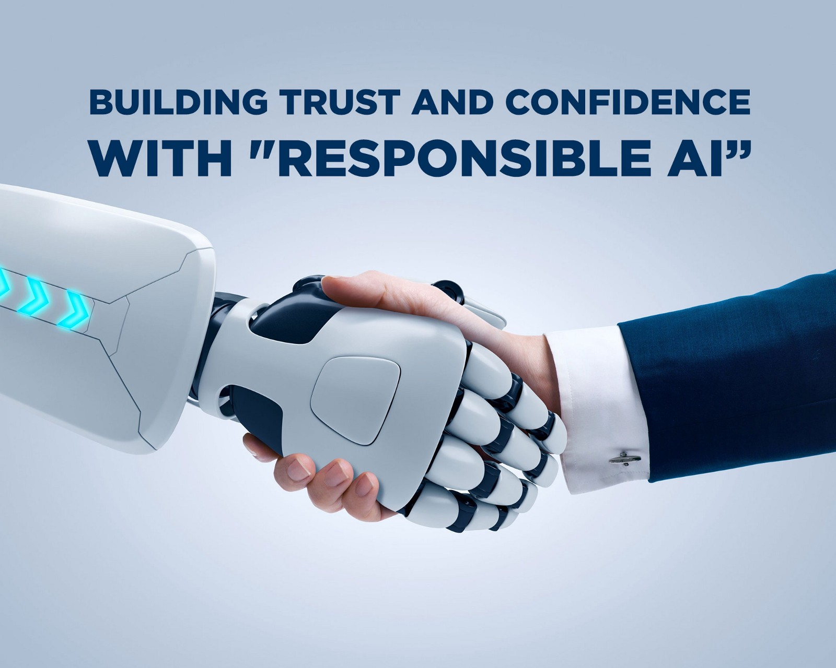
Notes:
• Promoting a culture of responsibility. AI researchers and the organizations that employ them are in a unique position to shape the security landscape of the AI-enabled world. Highlighting here the importance of education, ethical statements and standards, framings, norms, and expectations.
• Developing technological and policy solutions. In addition to the above, surveying a range of promising technologies, as well as policy interventions, that could help build a safer future with AI. High-level areas for further research include privacy protection, coordinated use of AI for public-good security, monitoring of AI-relevant resources, and other legislative and regulatory responses. These interventions require attention and action not just from AI researchers and companies but also from legislators, civil servants, regulators, security researchers and educators. The challenge is daunting and the stakes are as high as the AI tsunami already breaking upon the beachhead.

Slide 28

Notes:
AI Threat Intervention, Regulation and Control
Much of the above focuses on interventions that can be carried out by researchers and practitioners within the AI development community. However, there is a broader space of possible interventions, including legal ones that should be considered. Note that ill-considered government interventions could be counterproductive, and that it is important that the implications of any specific policy interventions in this area should be carefully analyzed. A number of questions concerning the proper scope for government intervention in AI security arise; some initial examples:

Slide 29
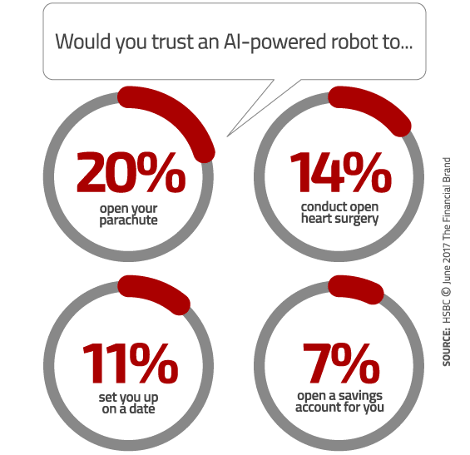
Notes:
• Is there a clear chain of responsibility for preventing AI security related problems?
• Which government departments, marketplace actors or other institutions would ideally have what responsibilities, and what would the interactions with the academic and industry communities be?
• How suitable would existing institutions be at playing this role, and how much will it require the establishment of new institutions founded on novel principles or innovative structures in order to effectively operate in such an evolving and technical field?
• Are relevant actors speaking to each other, and coordinating sufficiently, especially across political, legal, cultural and linguistic barriers?

Slide 30
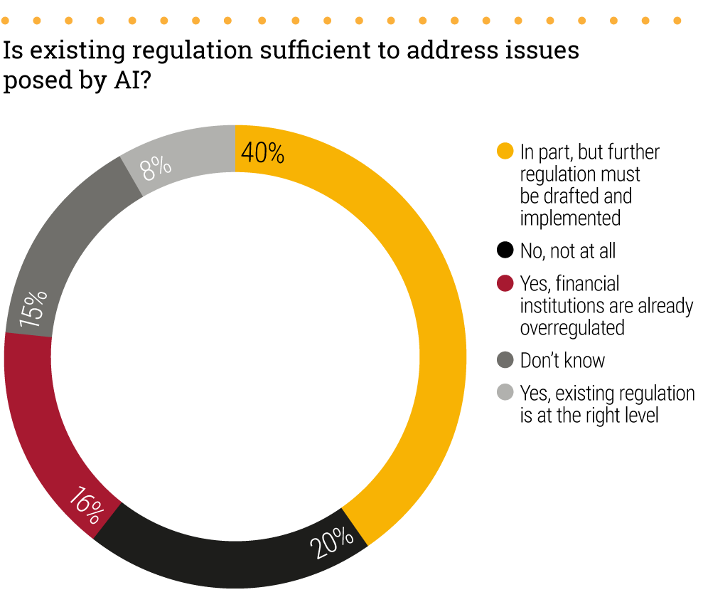
Notes:
• Are liability regimes adequate? Do they provide the right incentives for various actors to take competent defensive measures?
• How prepared does e.g. the US government feel, and how much appetite would there be for focused offices/channels designed to increase awareness and expertise?
• Should governments hold developers, corporations, or others liable for the malicious use of AI technologies? What other approaches might be considered for pricing AI security-related externalities ?
• What are the pros and cons of government policies requiring the use of privacy-preserving machine learning systems or defenses against adversarial examples and other forms of malicious use?

Slide 31
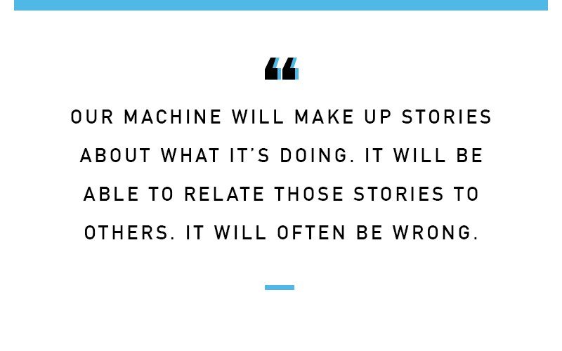
Notes:
• Are data poisoning and adversarial example attacks aimed at disrupting AI systems subject to the same legal penalties as traditional forms of hacking? If not, should they be?
• Should international agreements be considered as tools to incentivize collaboration on AI security?
• What should the AI security community’s “public policy model” be - that is, how should we aim to affect government policy, what should the scope of that policy be, and how should responsibility be distributed across individuals, organizations, and governments?
• Should there be a requirement for non-human systems operating online or otherwise interacting with humans (for example, over the telephone) to identify themselves as such to increase political security?

Slide 32

Notes:
• What kind of process can be used when developing policies and laws to govern a dynamically evolving and unpredictable research and development environment?
• How desirable is it that community norms, ethical standards, public policies and laws all say the same thing and how much is to be gained from different levels of governance to respond to different kinds of risk (e.g. near term/long term, technical safety / bad actor and high uncertainty / low uncertainty risks)?

Slide 33
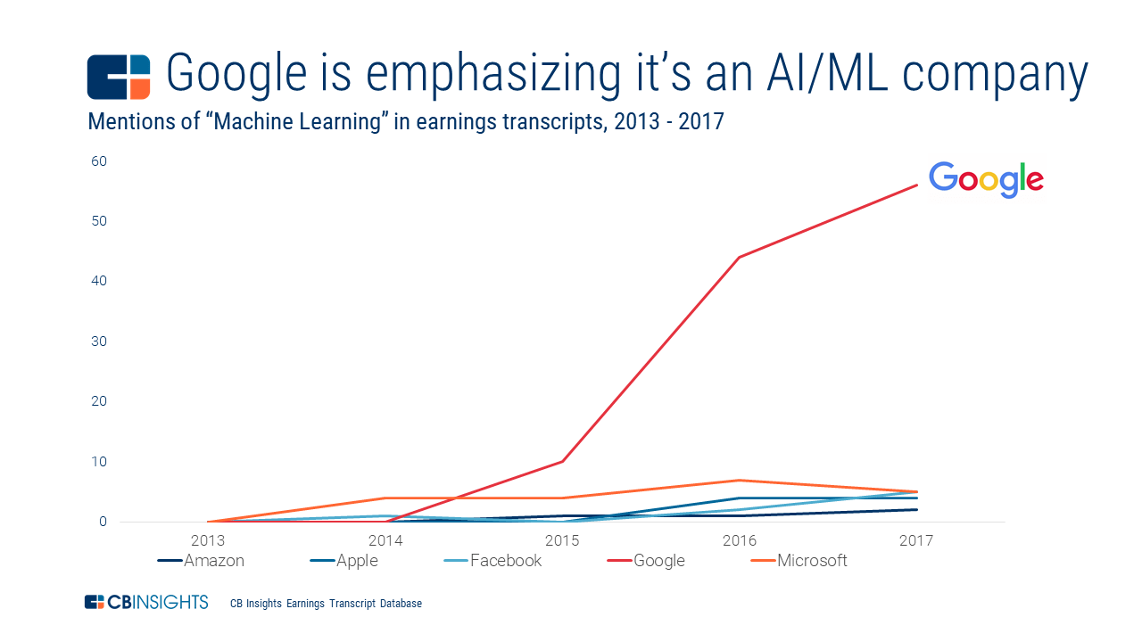
Notes:
Conclusions
It seems unlikely that interventions within the AI development community and those within other institutions, including policy and legal institutions, will work well over the long term unless there is some degree of strategic and tactical coordination between these groups. Ideally discussions about AI safety and security from within the AI community should be informing legal and policy interventions, and there should also be a willingness amongst legal and policy institutions to devolve some responsibility for AI safety to the AI community, as well as seeking to intervene on its own behalf. Achieving this is likely to require both a high degree of trust between the different groups involved in the governance of AI and a suitable channel to facilitate proactive collaboration in developing norms, ethics education and standards, policies and laws; in contrast, different sectors responding reactively to the different kinds of pressures that they each face at different times seems likely to result in clumsy, ineffective responses from the policy and technical communities alike.

Slide 34
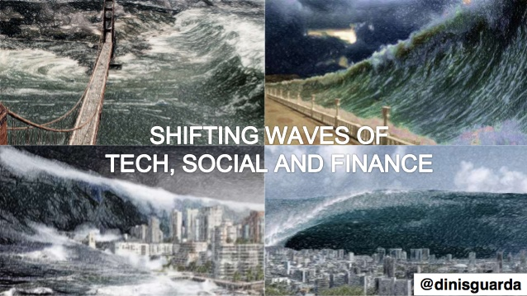
Notes:
Therefore, the sense of immediacy not only in recognizing the tsunami of AI has broken upon and established its beachhead, but in understanding the outright clear and present dangers it imposes advancing upon society as a whole and to the individual on this brave new worldwide quantum battlefield of human existence.

Slide 35
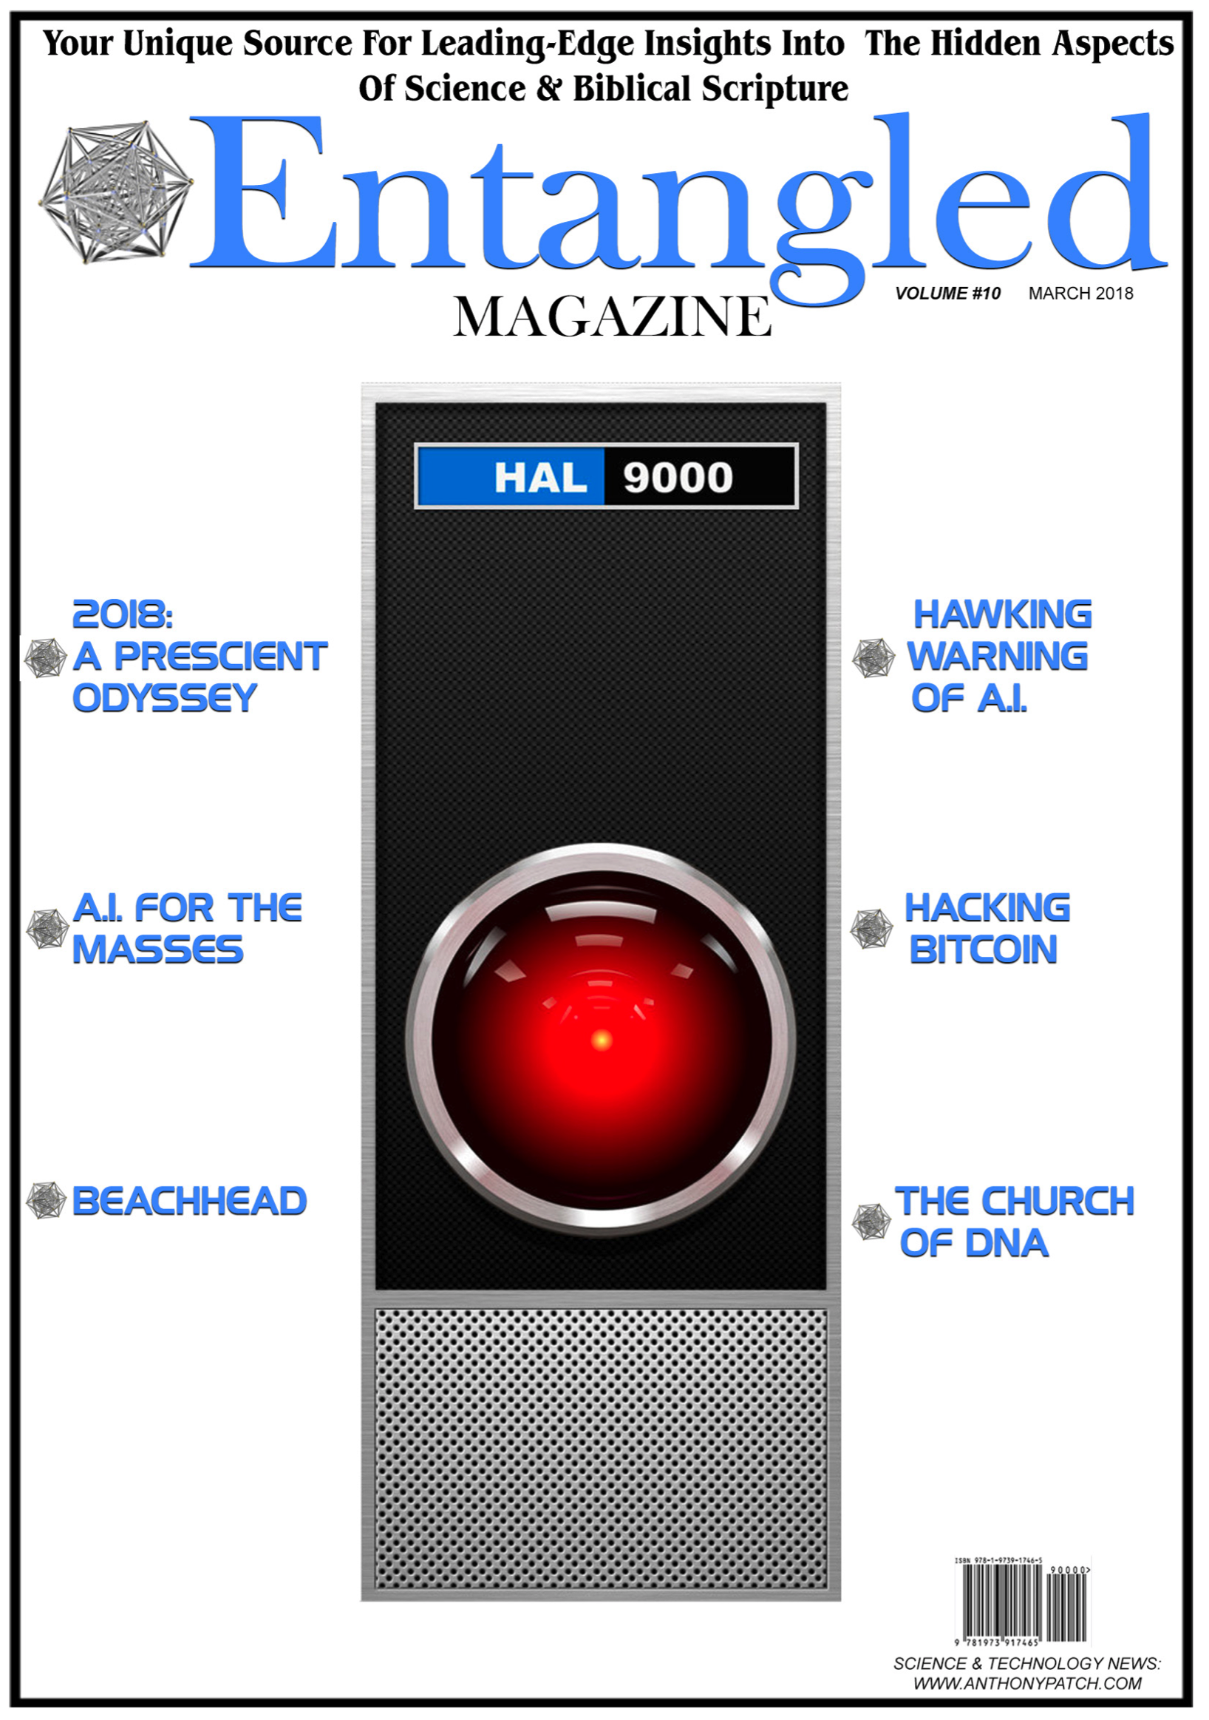

Anthony Patch
https://www.anthonypatch.com
https://www.patreon.com/anthonypatch

